Slide 1
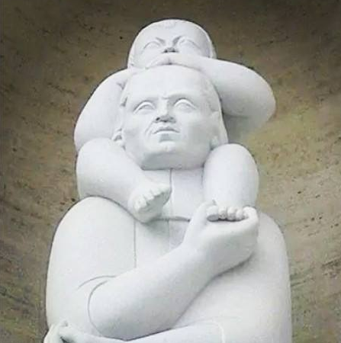
MARIST PRINCIPLES
Based on core Marist values …
… with a particular spirituality…
… we are a global Institute …
… immersed in the world of our times …
… with a new relationship among Brothers and lay…
… serving children and young people
Make Jesus known and loved (c.2) with a significant presence among poor children and young people.

Slide 2
MARIST PRINCIPLES
inspire

Slide 3
NEW MODEL PRINCIPLES
Make Jesus known and loved (c.2) with a significant presence among poor children and young people.
Passion for Marist life and Mission
Presence among children and young people
Co-responsibility, solidarity and subsidiarity
A global mindset
Interculturality
Creativity and innovation
Right competencies and attitudes
Transparency

Slide 4
PRINCIPLES
MARIST
NEW MODELS
Passion for the Marist life and Mission
Based on core Marist values …
Presence among children and young people
… with a particular spirituality…
Co-responsibility, solidarity and subsidiarity
… we are a global Institute …
A global mindset
… immersed in the world of our times …
Interculturality
Creativity and innovation
… with a new relationship among Brothers and lay…
Right competencies and attitudes
… serving children and young people
Transparency
Make Jesus known and loved (c.2) with a significant presence among poor children and young people.

Slide 5
GUIDELINES
ROAD MAP
Accompaniment and Formation
Sustainability and Vitality
NEW MODELS
International Institute - a Global Body
Presence among Children & Young
and co-responsibility
participation and co-responsibility by all
communion
appropriate structures

Slide 6
Which of the Guidelines do you consider to be the
most challenging in the context of your AU?
¿Cuáles consideras serían las líneas directrices más desafiantes para tu realidad?

Slide 7
Which of the Guidelines do you consider to be the most challenging in the context of your AU?
¿Cuáles consideras serían las desafiantes para tu realidad?
GUIDELINES
At the beginning of the third centennial we search for the most adequate ways to
ensure the Sustainability And Vitality of the Marist Mission.
We develop people who are happy, passionate and committed to the Marist charism; for them we promote experiences and accompaniment and formation processes at all levels of the Institute.
We identify ourselves as an international Institute acting as a global body
in all dimensions of the Marist life and Mission.
We prioritize the presence and closeness of Brothers and vocational lay people among the children and young people, especially the poor and vulnerable.
We experience and undertake communion and co-responsibility in the Marist Mission.
We take up at all levels of the Institute (AUs, Regions and General Government) participation and co-responsibility in the animation, government and management of the Marist Mission.
In order to respond to the calls and challenges of our Mission, we search for appropriate structures
and clearly define roles and responsibilities of people.

Slide 8
Our Marist principles …
Overview and key principles
One Mission
Make Jesus known and loved (c.2) with a significant presence among poor children and young people.
Key components
Based on core Marist values …
Family spirit, love of work, in the way of Mary, presence …
… with humility, simplicity and modesty.
… with a particular spirituality…
Apostolic and Marian expressed today as mystics and prophets in communion
Marian face of the Church
… we are a global Institute …
One global body to serve our Mission.
Co-responsibility and global availability.
Sharing of resources.
… immersed in the world of our times …
Deeply connected with the Church and the society.
Thinking globally, acting locally
Able to benefit from innovation.
… with a new relationship among Brothers and lay…
Co-responsibility, spirit of communion, eventually forming a “charismatic family”.
Dialogue, mutual support, respect an learning from each other
… serving children and young people
Builders of the kingdom of God making Jesus known and loved,
Through education and evangelization with new methods and languages
In the new peripheries of the world.

Slide 9
… inspired some New Models Project principles
Overview and key principles
Passion for the Marist life and Mission
The vitality of the Mission is result of the passion for Marist life and commitment of Brothers and lay people performing a charismatic family.
Presence among children and young people
New languages and methods.
Special among the vulnerable and poor.
Listening, available, welcoming and accompanying their life´s processes .
Co-responsibility, solidarity and subsidiarity
In the life and Mission at all levels and dimensions of the Marist charism.
Among Brothers and lay people, with a significant women's role.
In the decision making and in the allocation of resources.
Global mindset
Act as a single body strengthening our international identity.
Cross cultural competencies.
In interdependency and cooperation with strong mobility and agility.
Interculturality
Recognizing we are different and complementary.
Learning from each other.
Creativity and innovation
Responding to the calls and challenges of the children and young people .
In the style of leadership.
In the proposals and resources.
Right competences and attitudes
Develop spiritual, ecclesial and professional leaderships on all dimensions.
Building and strengthening the core competences, attitudes and behaviors.
Transparency
In resource allocation and use.
In communication internal and external.
In the behaviour and attitudes of people.

Slide 10
At the beginning of the third centennial we search for the most adequate ways to
ensure the Sustainability And Vitality of the Marist Mission.
We develop people who are happy, passionate and committed to the Marist charism; for them we promote
experiences and accompaniment and formation processes
at all levels of the Institute.
We identify ourselves as an
international Institute acting as a global body
in all dimensions of the Marist life and Mission.
We prioritize the
presence and closeness of Brothers and vocational lay people among the children and young people, especially the poor and vulnerable.
We experience and undertake communion and co-responsibility in the Marist Mission.
We take up at all levels of the Institute (AUs, Regions and General Government)
participation and co-responsibility
in the animation, government and management of the Marist Mission.
In order to respond to the calls and challenges of our Mission, we search for
appropriate structures
and clearly define roles and responsibilities of people.

